Slide 1
Going Deeper with Convolutional Neural Network for Stock Market Prediction
Advisor : Dr. Yu-Yen Ou
Student : Rosdyana Mangir Irawan Kusuma
TAIWAN, MARCH 2018

Slide 2
OUTLINE
INTRODUCTION
RELATED WORK
METHODOLOGY
RESULT

Slide 3
INTRODUCTION

Slide 4



INTRODUCTION
TRADER
EXCHANGE
STOCK MARKET

Slide 5
INTRODUCTION
MOTIVATIONS
Prediction on stock market prices are a great challenge due to fact that it’s immensely complex, chaotic and dynamic environment, it has proven to be a very difficult task.
No similar work was done for the Taiwan and Indonesian market.

Slide 6
INTRODUCTION
GOALS
Prove that data driven (price driven) still can be manage for stock market prediction.
Using deeper CNNs architecture to get good result
This work try to predict if the price of a particular stock is going to go up or down in the near future.

Slide 7
RELATED WORK
Title | Author | Year
On the Effectiveness of Candlestick Chart Analysis for the Brazilian Stock Market | Hércules A. ,doPradoaEdilsonFernedaaLuis, C.R.MoraisaAlfredo, ,J.B.LuizbEduardoMatsurac | 2013
Stock Prediction by Searching for Similarities in Candlestick Charts | Chih-Fong Tsai, Zen-Yu Quan | 2014
Deep Stock Representation Learning: From Candlestick Charts to Investment Decisions | Guosheng Hu, Yuxin Hu, Kai Yang, Zehao Yu, Flood Sung, Zhihong Zhang, Fei Xie, Jianguo Liu, Neil Robertson, Timothy Hospedales, Qiangwei Miemie | 2017

Slide 8
do Prado, Hércules A., et al. "On the effectiveness of candlestick chart analysis for the Brazilian stock market." Procedia Computer Science 22 (2013): 1136-1145.
Using candlestick charts to study the behavior of brazilian stock market with 16 candlestick patterns
Only using statistical and frequential analysis.

Slide 9
Tsai, Chih-Fong, and Zen-Yu Quan. "Stock prediction by searching for similarities in candlestick charts." ACM Transactions on Management Information Systems (TMIS) 5.2 (2014): 9.
Candlestick chart analysis method for making stock predictions based on the idea of content-based image retrieval (CBIR).
Using seven different wavelet-based texture features from candlestick charts
DJIA (Dow Jones Industrial Average Index) data

Slide 10
Hu, Guosheng, et al. "Deep Stock Representation Learning: From Candlestick Charts to Investment Decisions." arXiv preprint arXiv:1709.03803 (2017).
A novel investment decision strategy (IDS) based on deep learning.
Convolutional AutoEncoder to learn a stock representation of candlestick charts.
Financial Times Stock Exchange 100 Index (FTSE 100) data.

Slide 11
METHODOLOGY

Slide 12
METHODOLOGY DESIGN
DATA COLLECTION
DATA PREPROCESSING
LEARNING ALGORITHM
MODEL AND TESTING EVALUATIONS
FINAL RESULT
1
2
3
4
5

Slide 13
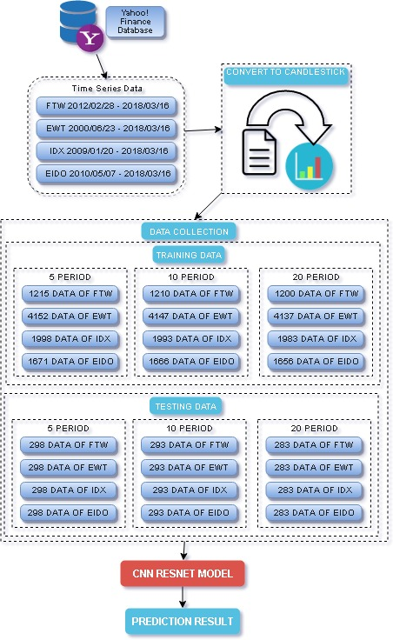

Slide 14

DATA COLLECTION
USING YAHOO! FINANCE API.
SYMBOL | TRAINING DATA |  | TESTING DATA
FTW | 2012/02/28 | 2016/12/31 | 2017/01/03 | 2018/03/16
ETW | 2000/06/23 | 2016/12/31 | 2017/01/03 | 2018/03/16
IDX | 2009/01/20 | 2016/12/31 | 2017/01/03 | 2018/03/16
EIDO | 2010/05/07 | 2016/12/31 | 2017/01/03 | 2018/03/16
*TOP ETF BASED ON ETFDB.COM

Slide 15
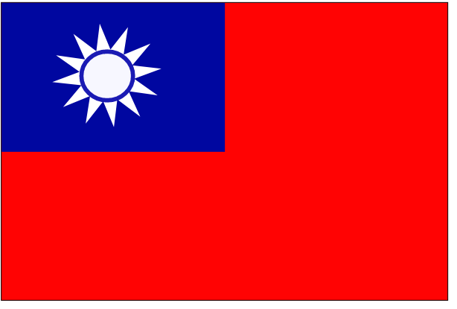

DATA COLLECTION
SYMBOL | COUNTRY | TRAINING DATA | TESTING DATA
FTW |  | 1221 TD | 297 TD
EWT |  | 4158 TD | 297 TD
IDX |  | 2004 TD | 297 TD
EIDO |  | 1677 TD | 297 TD

Slide 16
DATA COLLECTION
 | 5 PERIODS |  | 10 PERIODS |  | 20 PERIODS
SYMBOL | TRAINING | TESTING | TRAINING | TESTING | TRAINING | TESTING
FTW | 1215 | 298 | 1210 | 293 | 1200 | 283
EWT | 4152 | 298 | 4147 | 293 | 4137 | 283
IDX | 1998 | 298 | 1993 | 293 | 1983 | 283
EIDO | 1671 | 298 | 1666 | 293 | 1656 | 283

Slide 17
DATA PREPROCESSING
SLIDING WINDOWS
CONVERT TO CANDLESTICK
LABELLING
Using Sliding window to generate days period.
Using matplotlib to convert from stock market data ( Open, Close, High, Low and Volume ) into custom Candlestick Chart.
Labelling dataset based on signal ( 1, 0 ).

Slide 18
SLIDING WINDOW
W1
W2
D1
D2
D3
D4
D5
D1
D2
D3
D4
D5
CANDLESTICK DATA
LABEL
CANDLESTICK DATA
LABEL
CANDLESTICK DATA
LABEL
CANDLESTICK DATA
LABEL
CANDLESTICK DATA
LABEL

Slide 19
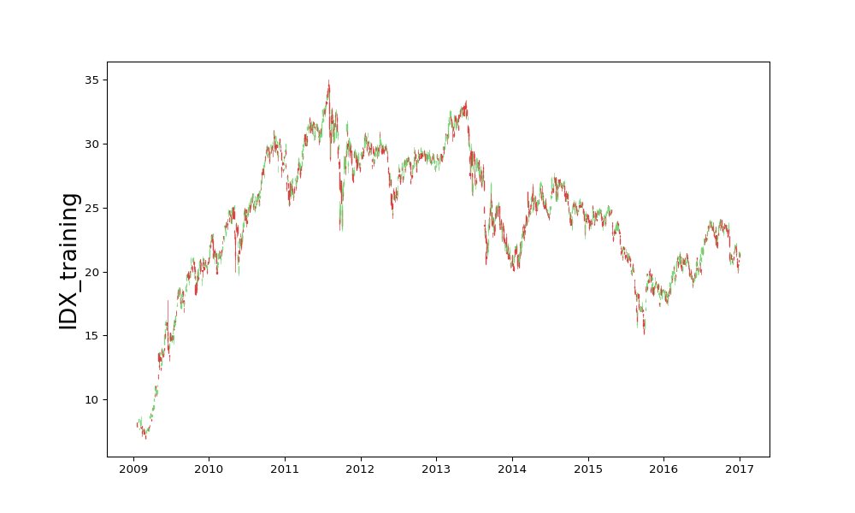
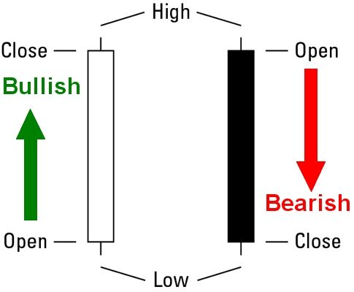
CANDLESTICK CHART

Slide 20
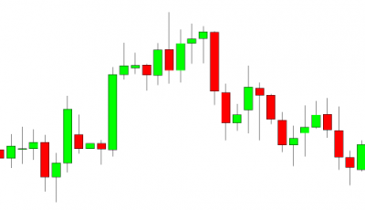
SPECIAL CANDLESTICK CHART
OHLC INDICATOR
48
VOLUME INDICATOR
GENERAL CANDLESTICK CHART
48
OUR CANDLESTICK CHART

Slide 21
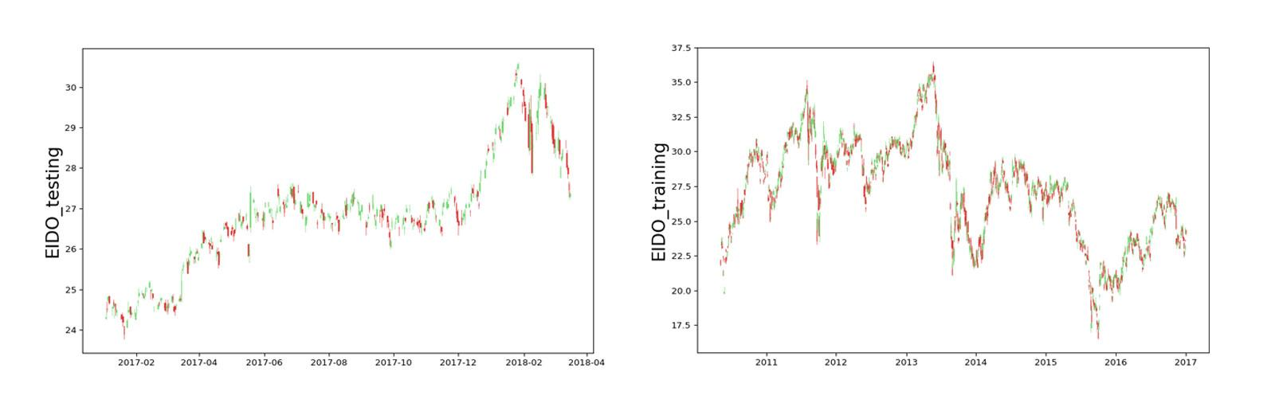
CANDLESTICK CHART
FULL DATASET IN CANDLESTICK CHART

Slide 22
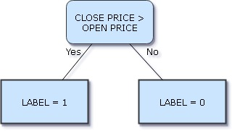
LABELLING DATASET
Using n-period days for labelling the binary classification.

Slide 23
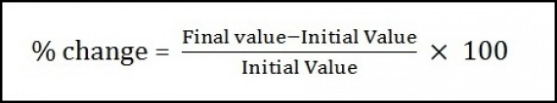
LABELLING DATASET
Calculate the percentage change from sequence to labeling the multi classification.
Open Price, Close Price
N <= -2 %
N > -2 % & N < 0
N > 0 & N < 2
N >= 2
N == 0
A
B
C
D
E

Slide 24
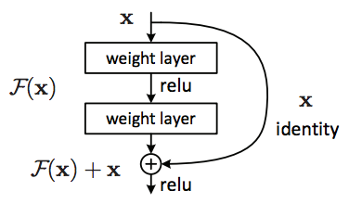
LEARNING ALGORITHM
CNN with ResNet Architecture.
Recognize visual patterns directly from pixel images.
Increasing the depth should increase the accuracy of the network, as long as over-fitting is taken care of.
https://www.kdnuggets.com/2017/08/intuitive-guide-deep-network-architectures.html

Slide 25
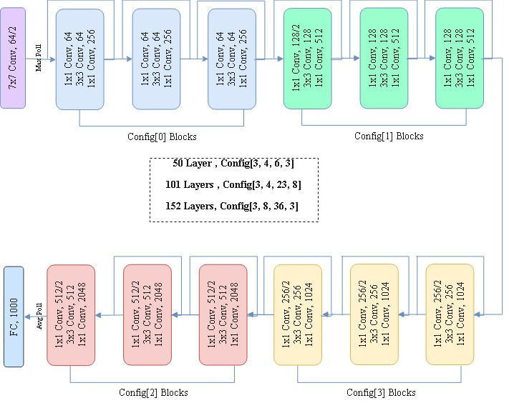

Slide 26
Summary of CNNs architecture
Year | CNN | Developed by | Top-5-error rate
2012 | AlexNet | Alex Krizhevsky, Geoffrey Hinton, Ilya Sutskever | 15.3 %
2013 | ZFNet | Matthew Zeller, Rob Fergus | 14.8 %
2014 | GoogLeNet | Google | 6.67 %
2014 | VGG Net | Simonyan, Zisserman | 7.3 %
2015 | ResNet | Kaiming He | 3.57 %

Slide 27

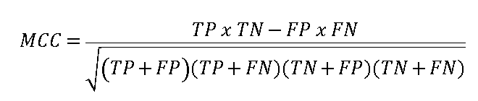


PERFORMANCE EVALUATION

Slide 28
RESULT

Slide 29
RESNET - 152
SYMBOL | ACC | SENSITIVITY | SPECITIVITY | MCC
FTW
EWT
IDX
EIDO

Slide 30
RESNET 50
 | 5 PERIODS |  |  |  | 10 PERIODS |  |  |  | 20 PERIODS
 | EWT | FTW | EIDO | IDX | EWT | FTW | EIDO | IDX | EWT | FTW | EIDO | IDX
Acc | 82.20% | 86.20% | 81.90% | 81.50% | 90.80% | 87.40% | 81.90% | 84.00% | 92.90% | 84.80% | 78.80% | 82.00%
Spec | 80.50% | 86.80% | 81.90% | 78.60% | 86.50% | 88.50% | 77.80% | 80.20% | 90.60% | 78.30% | 73.50% | 77.70%
Sens | 83.40% | 85.70% | 81.90% | 84.30% | 93.40% | 86.50% | 85.00% | 86.60% | 93.90% | 88.70% | 81.60% | 84.10%
MCC | 63.60% | 72.50% | 63.70% | 63.10% | 80.30% | 74.40% | 63.00% | 66.90% | 83.50% | 67.40% | 54.20% | 60.50%

Slide 31
RESNET 101
 | 5 PERIODS |  |  |  | 10 PERIODS |  |  |  | 20 PERIODS
 | EWT | FTW | EIDO | IDX | EWT | FTW | EIDO | IDX | EWT | FTW | EIDO | IDX
Acc | 79.20% | 87.20% | 82.60% | 77.90% | 88.40% | 86.00% | 76.80% | 78.50% | 91.20% | 64.30% | 79.20% | 80.90%
Spec | 75.60% | 88.20% | 81.20% | 70.30% | 81.10% | 88.50% | 67.50% | 88.40% | 89.40% | 7.50% | 73.50% | 75.50%
Sens | 81.70% | 86.40% | 83.80% | 85.00% | 92.90% | 84.20% | 83.80% | 71.50% | 91.90% | 98.30% | 82.20% | 83.60%
MCC | 57.20% | 74.50% | 64.90% | 56.00% | 75.10% | 71.90% | 52.30% | 59.20% | 79.60% | 14.70% | 54.80% | 58.00%

Slide 32
RESNET 152
 | 5 PERIODS |  |  |  | 10 PERIODS |  |  |  | 20 PERIODS
 | EWT | FTW | EIDO | IDX | EWT | FTW | EIDO | IDX | EWT | FTW | EIDO | IDX
Acc | 80.50% | 84.90% | 77.90% | 77.90% | 89.10% | 88.40% | 77.80% | 81.90% | 92.60% | 86.90% | 69.30% | 81.60%
Spec | 68.30% | 85.40% | 75.40% | 64.10% | 83.80% | 86.90% | 79.40% | 80.20% | 91.80% | 83.00% | 52.00% | 68.10%
Sens | 89.10% | 84.40% | 80.00% | 90.80% | 92.30% | 89.50% | 76.60% | 83.10% | 91.80% | 89.30% | 78.40% | 88.40%
MCC | 59.50% | 69.80% | 55.40% | 57.30% | 76.70% | 76.20% | 55.50% | 63.00% | 82.90% | 72.10% | 31.00% | 57.80%

Slide 33
CONCLUSION
We achieved the best result using ResNet 50 around 92.90% with EWT and 20 period days.
We successfully using candlestick chart to predict stock market according to the good result.

Slide 34
FUTURE WORKS
Image augmentation for data processing.
Prediction on multiclass to prove the architecture.
Web service to easy understanding.

Slide 35
THANK YOU

Slide 36
1x1 Conv, 64
3x3 Conv, 64
1x1 Conv, 256
1x1 Conv, 64
3x3 Conv, 64
1x1 Conv, 256
1x1 Conv, 64
3x3 Conv, 64
1x1 Conv, 256
1x1 Conv, 128/2
3x3 Conv, 128
1x1 Conv, 512
1x1 Conv, 128/2
3x3 Conv, 128
1x1 Conv, 512
1x1 Conv, 128/2
3x3 Conv, 128
1x1 Conv, 512
7x7 Conv, 64/2
Cfg[0] blocks
Cfg[1] blocks

